Slide 1







Signals Revealing Street Gang Members on Twitter
Presented at the 4th Workshop on Computational Approaches to Social Modeling (ChASM 2016)
co-located with SocInfo 2016 Bellevue, WA, USA, 14th November, 2016
Lakshika Balasuriya
lakshika@knoesis.org
Sanjaya Wijeratne
sanjaya@knoesis.org
Derek Doran
derek@knoesis.org
Amit Sheth
amit@knoesis.org
Ohio Center of Excellence in Knowledge-enabled Computing (Kno.e.sis)
Wright State University, Dayton, OH, USA

Slide 2

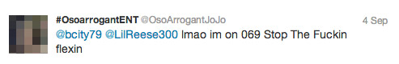
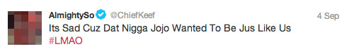
Tweets Source – http://www.wired.com/2013/09/gangs-of-social-media/all/ Image Source – http://www.7bucktees.com/shop/chi-raq-chiraq-version-2-t-shirt/ *Example tweets shown above are public data reported in the cited news paper article. They are not part of our research dataset.
Notes:
Tweets Source - http://www.wired.com/2013/09/gangs-of-social-media/all/
Image Source - http://www.7bucktees.com/shop/chi-raq-chiraq-version-2-t-shirt/
*Example tweets shown above are public data reported in the cited news paper article. They are not part of our research dataset

Slide 3

What does gang related research tell us?
“Gangs use social media mainly to post videos depicting their illegal behaviors, watch videos, threaten rival gangs and their members, display firearms and money from drug sales” [Patton 2015, Morselli 2013]
Studies have shown,
82% of gang members had used the Internet and 71% of them had used social media [Decker 2011]
45% of gang members have participated in online offensive activities and 8% of them have recruited new members online [Pyrooz 2013]
Image Source – http://www.sciencenutshell.com/wp-content/uploads/2014/12/o-GANG-VIOLENCE-facebook.jpg
Notes:
Image Source - http://www.sciencenutshell.com/wp-content/uploads/2014/12/o-GANG-VIOLENCE-facebook.jpg

Slide 4
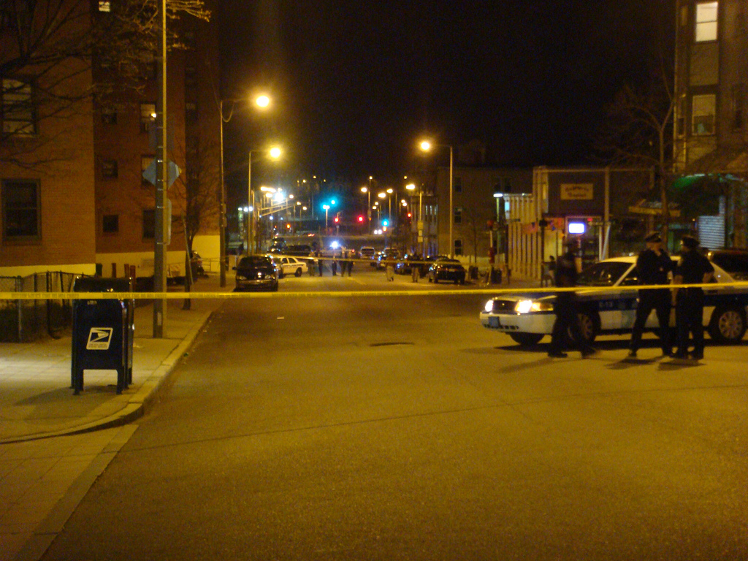
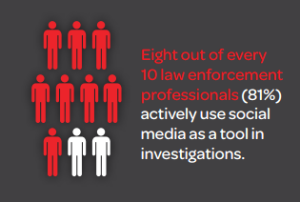
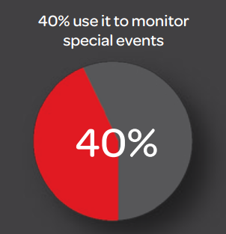
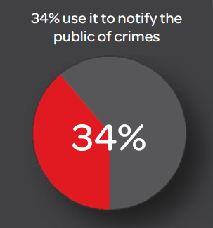
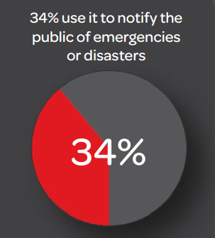
There are other spectators too…
Source – http://www.lexisnexis.com/risk/downloads/whitepaper/2014-social-media-use-in-law-enforcement.pdf
Image Source – http://www.officialpsds.com/images/stocks/crime-scene-stock1016.jpg
Notes:
Image Source - http://www.officialpsds.com/images/stocks/crime-scene-stock1016.jpg

Slide 5

But there’s a problem…
All applications required gang member profiles to be identified (done manually) before starting data processing
Source – http://www.lexisnexis.com/risk/downloads/whitepaper/2014-social-media-use-in-law-enforcement.pdf
Image Source – http://www.officialpsds.com/images/stocks/crime-scene-stock1016.jpg
Notes:
Image Source - http://www.officialpsds.com/images/stocks/crime-scene-stock1016.jpg

Slide 6
Signals Revealing Street Gang Members on Twitter
Balasuriya, Lakshika et al. “Finding Street Gang Members on Twitter”, In IEEE/ACM ASONAM 2016
Image Source – http://www.sciencenutshell.com/wp-content/uploads/2014/12/o-GANG-VIOLENCE-facebook.jpg
Notes:
Image Source - http://www.sciencenutshell.com/wp-content/uploads/2014/12/o-GANG-VIOLENCE-facebook.jpg

Slide 7
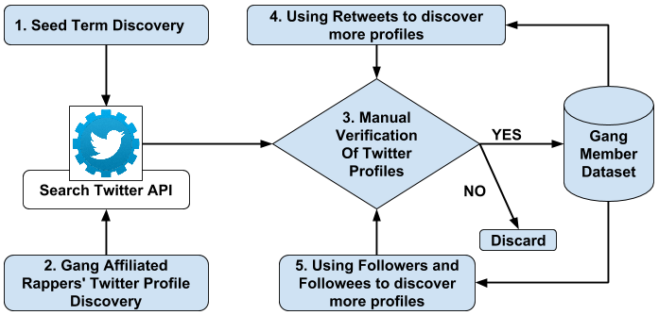
Data Collection
FreeDaGuys, RIPDaGuys, FreeMyNigga, FuckDaOpps
Gang Member Dataset Creation

Slide 8
Gang Member Dataset
We collected 400 gang members profiles
Non-gang member profiles were collected from Twitter Streaming and REST APIs
Filtered only US profiles – 2000 profiles collected
We added 865 manually verified non-gang member profiles collected from four seed words
To capture language used by family/friends of gang members
Description | Gang Member Class | Non-gang Member Class | Total
Number of Profiles | 400 | 2,865 | 3,265
Number of Tweets | 821,412 | 7,238,758 | 8,060,170

Slide 9
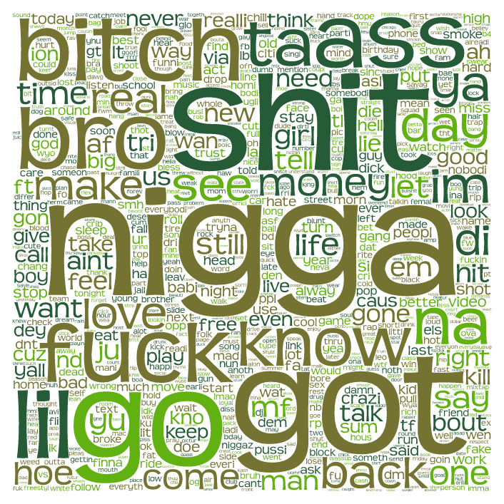

Data Analysis – Tweets
Words from Gang Member’s Tweets
Words from Non-gang Member’s Tweets

Slide 10
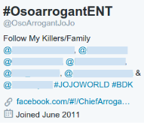
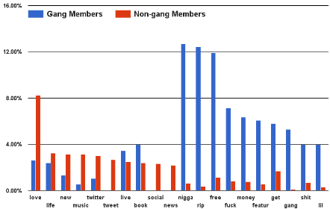
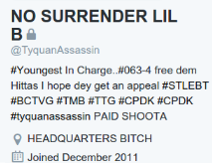
Data Analysis – Profile Descriptions
Percent of profiles that contain the word in profile description
Word usage in profile descriptions: Gang Vs. Non-gang members
*Example Twitter profiles shown above are public data reported in news articles. They are not part of our research dataset.
Notes:
*Example Twitter profiles shown above are public data reported in news articles. They are not part of our research dataset.

Slide 11
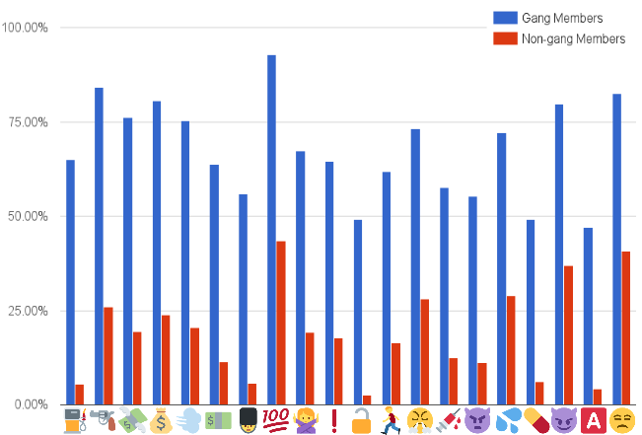
Data Analysis – Emoji
Percent of profiles that contains the emoji in Tweets
Emoji usage distribution: Gang Vs. Non-gang members

Slide 12
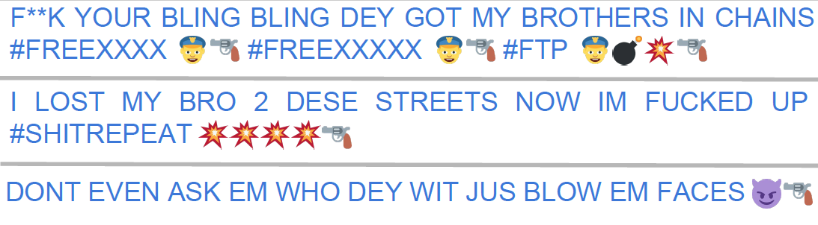



Data Analysis – Emoji Cont.
Emoji Chain | Gang Member Usage | Non-gang Member Usage
 | 32.25% | 1.14%
 | 53% | 1.71%
Emoji usage: Gang Vs. Non-gang members

Slide 13
Data Analysis – YouTube Links
51.25% of gang members post at least one YouTube video
76.58% of them are related to gangster hip-hop
A gang member shares 8 YouTube links on average
Top 5 words from gang members – shit, like, nigga, fuck, lil
Top 5 words from non-gang members – like, love, peopl, song, get

Slide 14
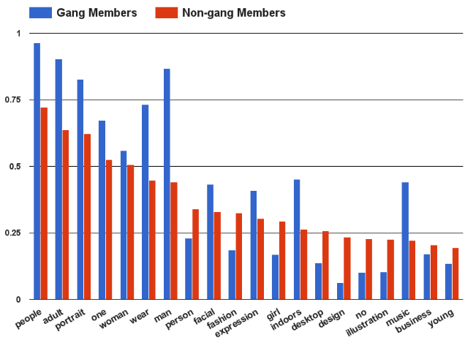
Data Analysis – Profile Images
Percent of profiles that contains the image tag
Image tags distribution: Gang Vs. Non-gang members

Slide 15
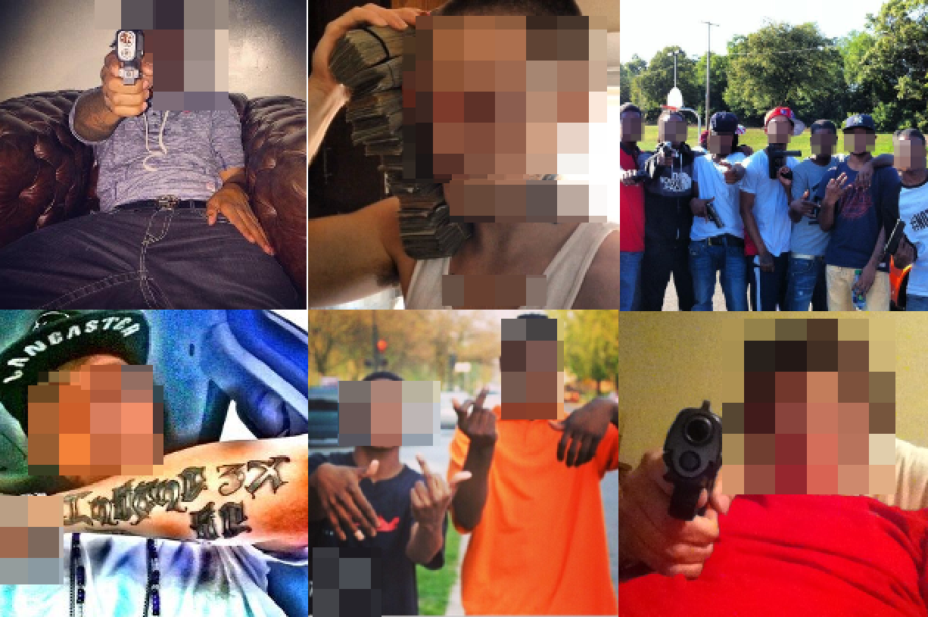
Data Analysis – Profile Images Cont.
Gang member tags – trigger, bullet, worship
Non-gang member tags – beach, seashore, pet
Gang Members’ Twitter Profile and Cover Images

Slide 16
Classification Approach
Used five feature types
Tweets, Profile Descriptions, Emojis, Profile and cover images, YouTube videos
Converted all non textual features to text
Emoji for Python API for emoji¹
Clarifai API for profile and cover images²
Removed stop word and stemmed the remaining
Represented Twitter profiles using unigrams
Trained four types of Classifiers (NB, LR, RF, SVM)
¹https://pypi.python.org/pypi/emoji | ²http://www.clarifai.com/

Slide 17
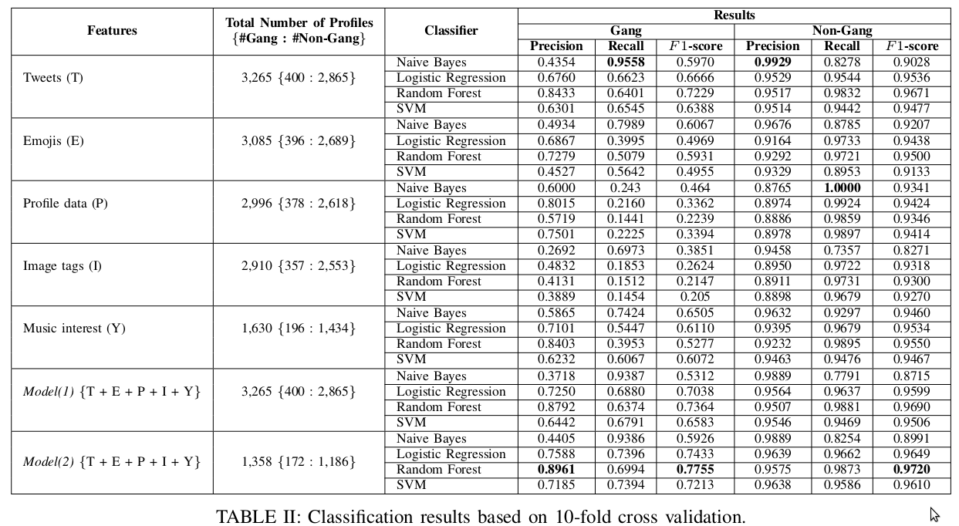
Classification Results

Slide 18
Our Classifier in Action
Twitter profiles collected from neighborhoods that are known for gang-related activities
Los Angeles, CA – 15,662 Profiles
Southside of Chicago – 8,500 Profiles
Classified using Model(2) RF Classifier and qualitatively studied the “Gang” class
Displayed weapons in their profile images
Gang-related names in their profile descriptions
Frequent use of curse words
Referred to known gang members as “my hommies”

Slide 19




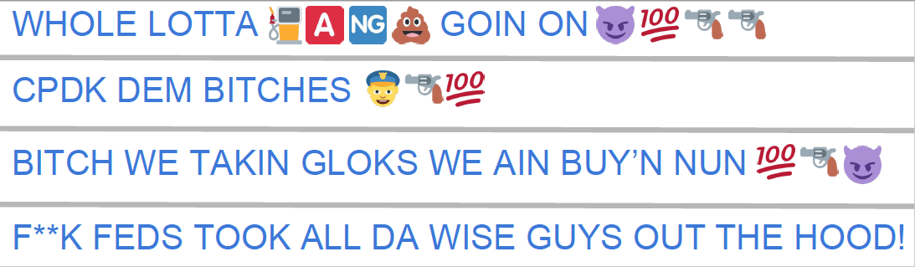
Our Classifier in Action Cont.
Most frequent words in Tweets
shit, nigga, got, bitch, go, fuck
Most frequent words in user profiles
free, artist, shit, fuck, freedagang, ripthefallen
Most frequent emoji –

Slide 20
Key Takeaway
Combining features from multiple modalities could improve classification accuracy, even with less training data
Using multiple modalities – Our classifiers combine textual data with features extracted from images, emoji and video descriptions and comments to improve classification accuracy
Using less training data – Model(2) which uses less than half of what Model(1) was trained on out performs Model(1)

Slide 21

Challenges and Future work
Build image recognition systems that can accurately identify images commonly posted by gang members
Guns, Drugs, Money, Gang Signs etc.
Integrate slang dictionaries and use them to pre-train word embeddings
Hipwiki.com
Utilize social networks of gang members to identify new gang members
Image Source – http://i.ytimg.com/vi/dqyYvIqjuFI/maxresdefault.jpg
Notes:
Image Source - http://i.ytimg.com/vi/dqyYvIqjuFI/maxresdefault.jpg

Slide 22




Connect with me
sanjaya@knoesis.org
@sanjrockz
http://bit.do/sanjaya
Image Source – http://www.pcb.its.dot.gov/standardstraining/mod08/ppt/m08ppt23.jpg
Notes:
Image Source - http://www.pcb.its.dot.gov/standardstraining/mod08/ppt/m08ppt23.jpg

Slide 23



Slide 24
References
[1] D. U. Patton, “Gang violence, crime, and substance use on twitter: A snapshot of gang communications in Detroit,” Society for Social Work and Research 19th Annual Conference: The Social and Behavioral Importance of Increased Longevity, Jan 2015
[2] C. Morselli and D. Decary-Hetu, “Crime facilitation purposes of social networking sites: A review and analysis of the cyber banging phenomenon,” Small Wars & Insurgencies, vol. 24, no. 1, pp. 152–170, 2013
[3] S. Decker and D. Pyrooz, “Leaving the gang: Logging off and moving on. Council on foreign relations,” 2011

Slide 25
References Cont.
[4] D. C. Pyrooz, S. H. Decker, and R. K. Moule Jr, “Criminal and routine activities in online settings: Gangs, offenders, and the internet,” Justice Quarterly, no. ahead-of-print, pp. 1–29, 2013
[5] S. Wijeratne, D. Doran, A. Sheth, and J. L. Dustin, “Analyzing the social media footprint of street gangs”, In Proc. of IEEE ISI, 2015, pages 91–96, May 2015.
[6] L. Balasuriya, S. Wijeratne, D. Doran, and A. Sheth, “Finding street gang members on twitter”, In The 2016 IEEE/ACM International Conference on Advances in Social Networks Analysis and Mining (ASONAM 2016). vol. 8, pp. 685–692. San Francisco, CA, USA (2016).

Slide 26
References Cont.
[7] S. Wijeratne, L. Balasuriya, D. Doran, A. Sheth, “Word Embeddings to Enhance Twitter Gang Member Profile Identification”, In IJCAI Workshop on Semantic Machine Learning (SML 2016). New York City, NY: CEUR-WS; 2016.

